Slide 1
Question Time
Computer Systems
Fundamentals
H175 34
Processors and Other Stuff

Slide 2
How it works
You will see a series of questions based on Outcome 2 of Computer Architecture.
This will be part quiz, part discussion.
You may work in small teams if you wish.
Write your answers down as we go.
Each discussion point or question will be displayed for 30 seconds before we move on.

Slide 3

Ready???

Slide 4
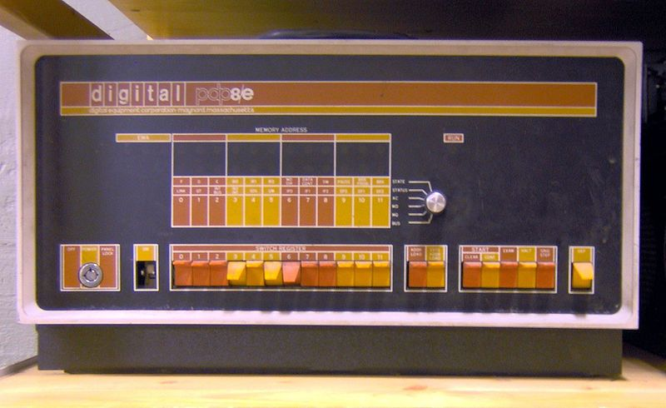
Question 1.
Which of the following represents the boot sequence of a PC?
BIOS, OS load, POST
BIOS, POST, OS load
POST, BIOS, OS load
POST, OS load, BIOS

Slide 5
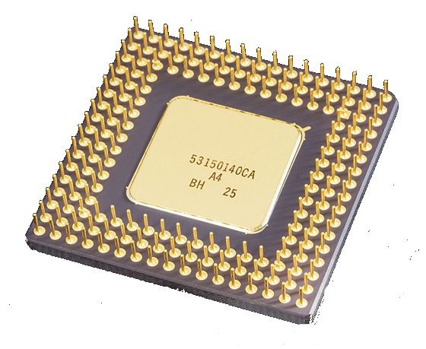
Question 2.
Which one component of the CPU is responsible for storing the address of the data or instruction currently being accessed?
Address Bus
Instruction Register
Memory Address Register
Program Counter

Slide 6
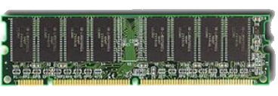
Question 3.
What does the term non volatile storage mean?
All the information in memory is lost when the power is turned off
All the information is retained even when the power is turned off
If there is no fan attached to the processor it would overheat and burn out
It requires a circuit breaker to prevent damage from a power surge

Slide 7

Question 4.
What is the result of a logical AND arithmetic calculation between 10110011 and 10010011?
00110011
10010011
10100011
10110011

Slide 8
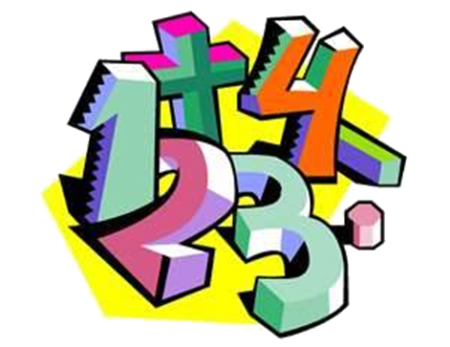
Question 5.
Which component of the central processing unit is responsible for carrying out arithmetic calculations?
Accumulator
Arithmetic and Logic Unit
Control Unit
Floating Point Unit

Slide 9
Question 6.
Another word for the CPU is the –
Executor
Decoder
Microchip
Microprocessor

Slide 10
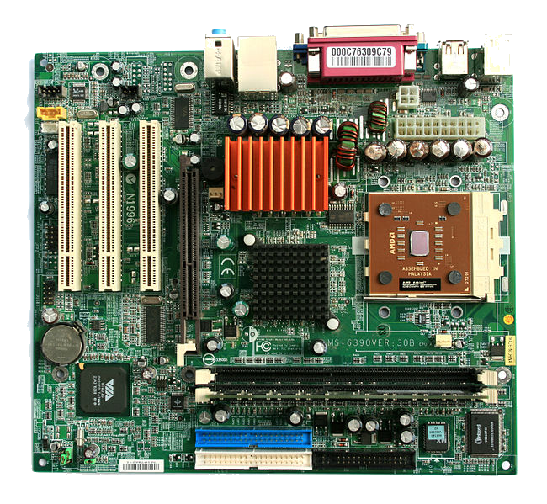
Question 7.
Which of the following is NOT a type of expansion slot or bus design used in Advanced-Technology class systems?
PCMCIA
ISA
PROM
EISA

Slide 11
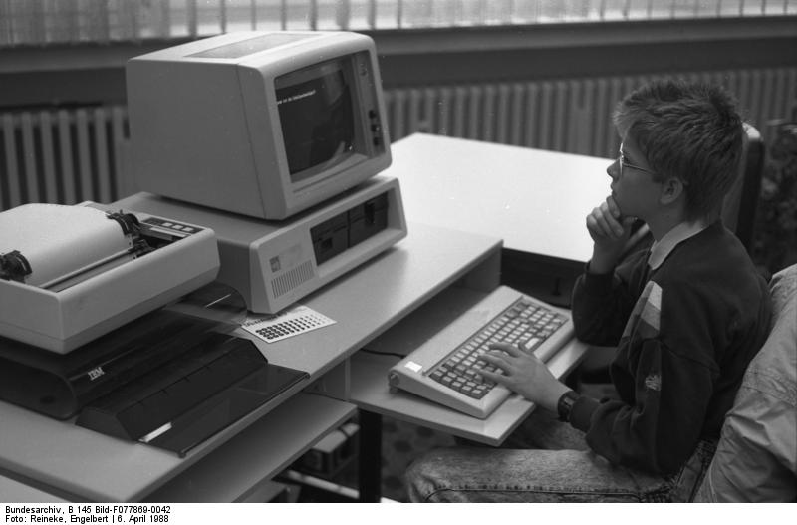
Question 8.
What was the clock speed of the original IBM PC?
Less than 5 MHz
10 MHz
8 MHz
Just over 16 MHz

Slide 12

Question 9.
A program that neither replicates or copies itself, but does damage or compromises the security of the computer. Which 'Computer Virus' it is?
Joke Program
Worm
Trojan
Hoax

Slide 13
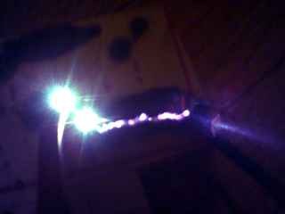
Question 10.
What can consist of two plates separated by a dielectric and can store a charge?
Inductor
Capacitor
Transistor
Relay

Slide 14
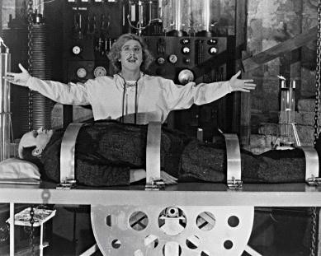
Ready for the answers?

Slide 15
Question 1.
Which of the following represents the boot sequence of a PC?
BIOS, OS load, POST
BIOS, POST, OS load
POST, BIOS, OS load
POST, OS load, BIOS
PDP-8/E front panel showing the switches used to load the bootstrap

Slide 16
Question 2.
Which one component of the CPU is responsible for storing the address of the data or instruction currently being accessed?
Address Bus
Instruction Register
Memory Address Register
Program Counter
Intel 80486DX CPU. Bottom view with gold plated pins

Slide 17
Question 3.
What does the term non volatile storage mean?
All the information in memory is lost when the power is turned off
All the information is retained even when the power is turned off
If there is no fan attached to the processor it would overheat and burn out
It requires a circuit breaker to prevent damage from a power surge

Slide 18
Question 4.
What is the result of a logical AND arithmetic calculation between 10110011 and 10010011?
00110011
10010011
10100011
10110011
Remember the rules of the AND gate – both inputs must be a 1 to get a 1 out the other side!

Slide 19
Question 5.
Which component of the central processing unit is responsible for carrying out arithmetic calculations?
Accumulator
Arithmetic and Logic Unit
Control Unit
Floating Point Unit
Some processors have an inbuilt FPU. But it’s only used for numbers with decimal points or fractions!

Slide 20
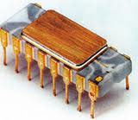
Question 6.
Another word for the CPU is the –
Executor
Decoder
Microchip
Microprocessor
The original microprocessor, as we would understand it, was released by Intel in 1971. It was basically a glorified Busicom calculator chip with 4-bit registers!

Slide 21
Question 7.
Which of the following is NOT a type of expansion slot or bus design used in Advanced-Technology class systems?
PCMCIA
ISA
PROM
EISA
A PROM is not an expansion slot – it is a chip!

Slide 22
Question 8.
What was the clock speed of the original IBM PC?
Less than 5 MHz
10 MHz
8 MHz
Just over 16 MHz
It was a smokin’ 4.77MHz. For various logistical reasons, the maximum speed possible remained at 4.77MHz for three years, increasing to a blistering 6 MHz by 1984!

Slide 23
Question 9.
A program that neither replicates or copies itself, but does damage or compromises the security of the computer. Which 'Computer Virus' it is?
Joke Program
Worm
Trojan
Hoax
A Trojan is not a true virus (although it is often classified as one) as it does not replicate or spread itself.
These are usually spread by email, or downloaded by the user themselves, mistakenly for a helpful or desirable program.

Slide 24
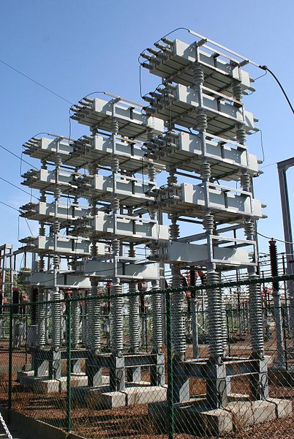
Question 10.
What can consist of two plates separated by a dielectric and can store a charge?
Inductor
Capacitor
Transistor
Relay
Some very large capacitors at an electricity substation in the Netherlands.

Slide 25
credits
Young Frankenstein - http://forums.techguy.org/thread-games-arcade-discussion/974644-google-picture-game-2-a-4.html
PDP-8E from Wikimedia Commons under GNU l;icence
Intel 80486DX from Wikimedia Commons, CC Licence (Solipsist)
MicroATX – Wikimedia Commons (© Jonathan Zander)
IBM-PC provided to Wikimedia Commons by the German Federal Archive (Deutsches Bundesarchiv) as part of a cooperation project
75MVAR substation capacitor bank at 150kV – Wikimedia (Public Domain)

